Slide 1
Fun with
R2T4’s
Rachel Cavenaugh
Cape Fear Community College
Melissa Baity
Vance-Granville Community College
Date November 6, 2024
Fall 2024: Climbing Higher Together

Slide 2
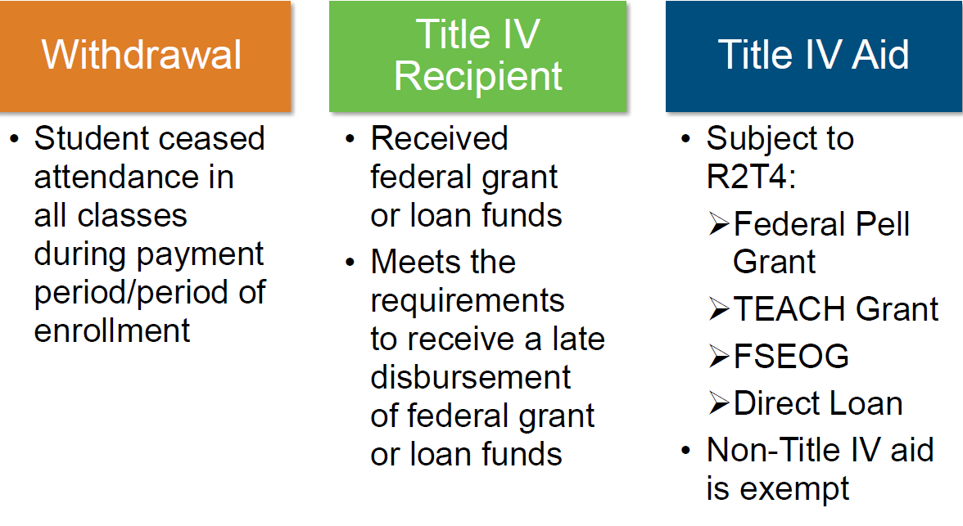
Key Concepts

Slide 3
Earned Aid is disbursed or undisbursed federal funds that the student may keep
Post-Withdrawal Aid are undisbursed federal funds the student has earned and could receive
Unearned aid are disbursed federal funds that the student does not qualify to keep

Slide 5
If a student does a partial withdraw and continues to do work in the class(es) they remain in an R2T4 is not needed
If the student was not eligible for federal funds and does a complete withdraw an R2T4 is not needed
If the student graduates an R2T4 is not needed
If a student passes away an R2T4 is needed. The school returns the funds but the student does not return funds
Fall 2024: Climbing Higher Together

Slide 6
If you are a non attendance taking school the date that you
use for the withdrawal is depending on whether it is an
Official Withdrawal or an unofficial withdrawal.
Official the student uses the withdrawal process for the
school so that is the date used
Unofficial is when the student does not complete a
withdrawal they just stop attending. Schools have to have
a grade or a way of showing the difference between an earned
F versus an unearned (walk away F).
Non attendance taking I use the midpoint of the term.
Fall 2024: Climbing Higher Together

Slide 7
Steps for R2T4 Calculation
Determine the Title IV aid disbursed and not disbursed
Figure the percentage of Title IV aid earned. This is based on how much of the term was completed. For credit hour programs it is the days attended divided by the days scheduled for the term. Exclude scheduled breaks of at least 5 consecutive calendar days. Clock hour programs is the scheduled hours divided by the hours in the period
Take the percentage and determine the amount of aid earned. This is total aid times the percentage completed equals earned aid. Total aid is disbursed aid plus aid that could have been disbursed. Disbursed aid minus earned aid equals unearned aid
The school’s share to return is the total amount of unearned aid or the amount equal to the charges times the percentage unearned whichever is less.
The student’s share is the difference between unearned aid they school’s share.
The order to return is Federal Loans (Unsubsidized, Subsidized PLUS) and then Grants (Pell then SEOG and TEACH)
The school has 45 days to return unearned funds
R2T4 Worksheets can be found in the FSA Handbook
Fall 2024: Climbing Higher Together

Slide 8
If you are an attendance taking school the date that you
use for the withdrawal is based on the last day of attendance
The last day of attendance is the last day of academic activity.
Students must be withdrawn after missing 14 calendar days of academic activity in a row.
Unearned funds must be returned to COD within 45 days.
Fall 2024: Climbing Higher Together

Slide 9
MODULES
One census date or a rolling census date?
Which module is completed after the 49% mark?
Did they attend 6 credit hours in the first module?
Fall 2024: Climbing Higher Together

Slide 12
Questions?

Slide 13
NCASFAA Thanks our Platinum Sponsors

Slide 14
NCASFAA Thanks our Gold Sponsors

Slide 15
Thank you for attending!
Fall 2024: Climbing
Higher Together

