Slide 1
The Basics of Gainful Employment and Financial Value Transparency
NCASFAA Fall 2024

Slide 2
Agenda
GE: History to Today
Reporting Requirements
Reporting Process
Metrics, Framework, and Impact
Popular Q&As

Slide 3
Gainful Employment
The History

Slide 4
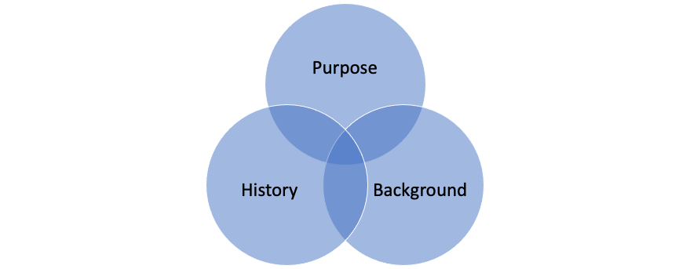
Why GE/FVT?

Slide 5
The Purpose of GE Rules
Higher Education Act (HEA) of 1965, as amended, requires all non-degree programs at public and private non-profit institutions and nearly all programs at propriety institutions to “prepare students for gainful employment in a recognized occupation”
Congress has avoided defining gainful employment, leaving the Department of Education to determine what constitutes gainful employment to ensure that the requirements of the HEA are satisfied
Notes:
Going way back to the Higher Education Act of 1965, non-degree programs public and private non-profits as well as nearly ALL programs at proprietary schools must “prepare students for gainful employment in a recognized occupation” You may have heard that quoted part many times before if you’ve been around since the last GE rules were in place.
Now you may notice, that doesn’t actually say what is considered gainful employment, so that leaves ED to determine what satisfies that requirement.
So how is it decided if schools are truly preparing those students for gainful employment, that is where these GE rules come in.

Slide 6
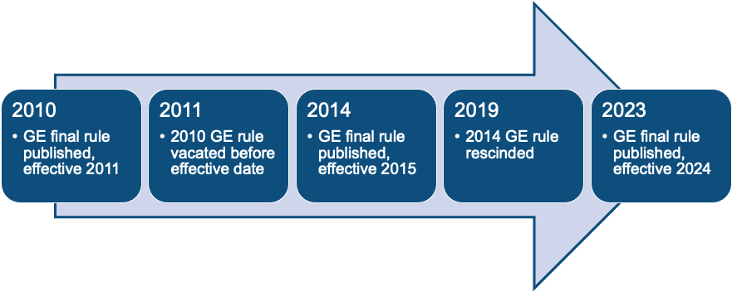
The Timeline of GE Rules
Notes:
The first GE final rule was published in 2010 during the Obama administration, and it was set to become effective in 2011. It was stuck down before the effective date ever came.
So next, in 2014, the next GE rule was published, with an effective date of 2015. This rule also ran into issues and was rescinded in 2019.
Skip ahead a few years, and we come to 2023 when this most recent GE rule was published, with an effective date of July 1, 2024. Now this rule goes beyond just GE, which I’m sure you know even if just from the title of this webinar, but we will get to that soon.

Slide 7
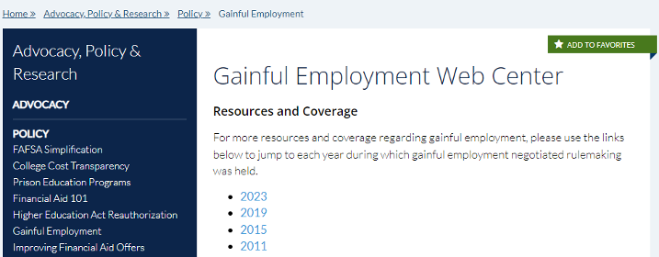
NASFAA’s GE Web Center
Notes:
While I mentioned we can’t dive into the details of each of these sets of rules, I want to highlight NASFAA’s Gainful Employment Web Center where you can view many many resources on the history of GE, including being broken down by each set of rules and their corresponding years.
So, if you are interested in those details, this is a great resource for you

Slide 8
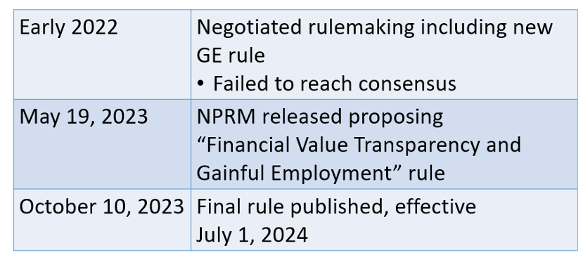
2023 Final Rule
Notes:
So coming back to the more recent history, let’s look at some key dates of the 2023 final rule. In early 2022, we had several sessions of negotiated rulemaking that included the new GE rule. They failed to reach consensus on the GE rule at that time.
Fast forward to May 2023, a notice of proposed rulemaking was released which officially proposed the financial value transparency and gainful employment rule.
The final rule was published on October 10, and again, that effective date is July 1, 2024.

Slide 9
2023 Final Rule: Purpose
“The Secretary establishes and amends regulations related to gainful employment (GE) to address ongoing concerns about educational programs designed to prepare students for gainful employment in a recognized occupation, but that instead leave them with unaffordable amounts of student loan debt in relation to their earnings, or with no gain in earnings compared to others with no more than a high school education. The Secretary separately seeks to enhance transparency by providing information about financial costs and benefits to students at nearly all academic programs at postsecondary institutions that are eligible to participate in title IV of the Higher Education Act of 1965, as amended (HEA).”
–Summary of October 10, 2023 Final Rule (bold added)

Slide 10
Who is impacted by the 2023 Final Rule?
YOU!

Slide 11
Who is required to report information?
The FVT requirements apply to all programs that participate in Title IV (GE or not)
Title IV eligibility framework for failing programs only applies to GE programs
668.408(a)(1) states schools must report required data for “each GE program and eligible non-GE program, for its most recently completed award year...”
Notes:
So looking at this further, if you take one piece of information away from me today, it’s that the FVT requirements apply to ALL programs that participate in Title IV aid (NOT JUST GE PROGRAMS)
An important piece of information is that, unlike for GE programs, a non-GE program’s failure of the GE metrics would not result in automatic loss of Title IV eligibility. Which we discuss later in this presentation

Slide 12
FVT Applies to Everyone
The FVT requirements apply to all programs that participate in Title IV (GE or not)
Title IV eligibility framework for failing programs only applies to GE programs
668.408(a)(1) states schools must report required data for “each GE program and eligible non-GE program, for its most recently completed award year...”

Slide 13
GE & Non-GE Programs
A GE program and an eligible non-GE program are specifically defined in 668.2(b)
For GE programs, the definition cross-references to 668.8, “Eligible program,” and includes only the following Title IV-eligible programs:
668.8(c)(3): “[A]t least a one-academic-year training program that leads to a certificate, or other nondegree recognized credential, and prepares students for gainful employment in a recognized occupation.”
668.8(d): “An eligible program provided by a proprietary institution of higher education or postsecondary vocational institution…”
Notes:
I did want to provide some citations with the definitions of GE and eligible non-GE programs. You can refer to these regulations if you are at all unsure, but very generally speaking, all nondegree programs (e.g., certificate programs, diploma programs) that lead to recognized credentials at public and private nonprofit institutions are GE Programs with a few small exceptions which we will discuss later.
All educational programs offered by for-profit (proprietary) institutions are GE Programs except for again a few exceptions.
One thing to note, that I know has come up over on AskRegs before is that: Some institutions offer degree programs where students may also be awarded a non-degree credential (e.g., certificate, diploma) after completing a portion of the degree program. Such programs are generally not considered GE Programs at non-profit and public institutions. However, a program where a significant number of the students enrolled in the program do not actually earn the degree and withdraw after obtaining the certificate may be, upon review, determined to be a non-degree program. In that case, the certificate program would then be considered a separate GE Program.
Eligible Non-GE Programs include all Title IV eligible programs, including degree programs, at public, private non-profit, and proprietary institutions, with a few exceptions.

Slide 14
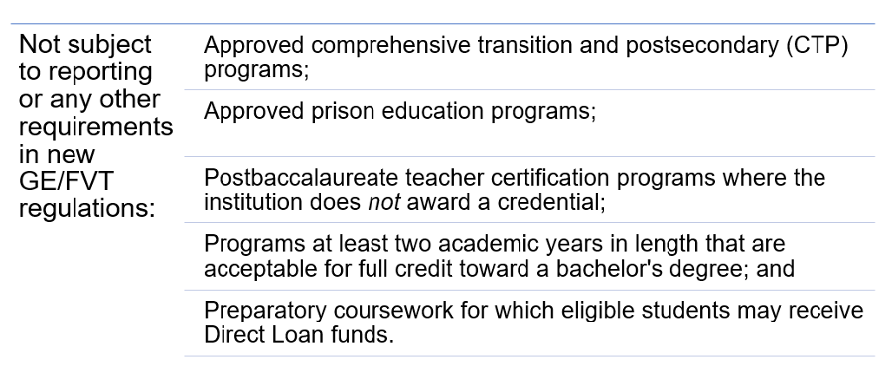
WHO is not required to report information?
Notes:
The following types of Title IV-eligible programs or coursework are considered neither GE programs nor Eligible Non-GE Programs.

Slide 15
Institutional Exclusions
Some institutions and all their programs are excluded from some or all requirements
Institutions with no groups of substantially similar programs (same four-digit CIP prefix) that produced at least 30 total completers over the preceding four award years
Not subject to any of the FVT or GE provisions
Institutions with main campuses located in a U.S. Territory or the Freely Associated States
Excluded from the GE accountability provisions and most FVT provisions, but must meet reporting requirements
Notes:
First, institutions with NO groups of substantially similar programs, which really is determined by having the same 4-figit CIP prefix) If they has no groups of substantially similar programs that had at least 30 completers in the last 4 years, they are totally excluded from all of the FVT and GE provisions. So these are likely very small schools. Later you are going to hear about some programs that have small numbers of completers and they don’t have metrics calculated…this is different than that. So please make a mental note of that for now. This is at the institutional level, the whole institution is excluded from the new rules. Now, a special note here: This is different than not calculating metrics for programs with small populations of students which we will talk about later. This is at the institutional level.
Second, institutions with main campuses in a US territory or Freely Associated States are excluded from the GE accountability provisions and most FVT provisions, but (big difference here) they still must fulfill the reporting requirements.

Slide 16
Reporting Requirements

Slide 17
WHAT are we required to report?
Institutions are required to report two types of data for each GE and eligible non-GE program [668.408]:
Program-level data
Programs are identified by six-digit OPEID, six-digit CIP code, and credential level
Reporting not required for excluded program types
Student -Specific Data
Enrolled
Completers and withdrawn
Reporting will be completed on an annual basis
Notes:
data elements are divided into two groupings—program-level data and student-specific data. Educational programs for your program-level reporting are identified using a combination of your school’s six-digit OPEID, the program’s six-digit CIP code, and the program credential level. For example, if your school offers a bachelor’s degree in computer as well as a master’s degree, then you have two separate computer science programs that you’ll provide data for. Student-specific data will be reported for students who received Title IV aid for a program, and is either currently enrolled, or has graduated or withdrawn.

Slide 18
Program-Level Data
Program name, six-digit CIP code, credential level, and program length
Weeks in program academic year
Whether the program is programmatically accredited
Name of accrediting agency, if applicable
States in the metropolitan statistical area in which the institution’s main campus is located where the program does or does not prepare students for licensure
Program totals
Students enrolled in the program (Title IV and non-Title IV recipients)
Graduates who took a licensure exam
Graduates who passed a licensure exam
Whether the program is a “qualifying graduate program”
Notes:
Up to five states can be reported in the institution’s metropolitan statistical area (MSA) in which the program does not meet licensure requirements or prepares students to sit for a licensure exam in a particular occupation.
Also, when reporting the totals for enrolled students and graduate who took as well as those who passed a licensing exam, those total will include all students in those programs who fall into those categories–whether they received Title IV aid or not.
And finally, you will need to designate whether the program you’re reporting is a qualifying graduate program. To be considered a QGP, the program has to meet specific criteria, so let’s talk a little more about them.

Slide 19
Qualifying Graduate Programs
A program whose students must complete required postgraduation training programs to obtain licensure to practice in the field
Must be accredited by an agency that meets State requirements if a State has such requirements for licensure; and
At least half of a program’s graduates must obtain licensure in a State where the postgraduation training requirements apply
For the 2026-27 award year, and every three years thereafter, ED will publish a new list of graduate degree fields in the Federal Register that may contain qualifying graduate programs

Slide 20
Qualifying Graduate Programs
Notes:
For this three year period, the fields that ED has determined may contain qualifying graduate programs are: medicine, osteopathy, dentistry, clinical psychology, marriage and family therapy, clinical social work, and clinical counseling. So for program-level reporting purposes, if you indicate that a program is a qualifying graduate program, the program must be in one these fields, and you’re also attesting that the program has the acceptable accreditation (if your State requires it) and that at least half of the program’s graduates obtain licensure in a State where the postgraduation training requirements apply.
Remember this is the list for the current three-year period which ends with the 2025-26 award year. You’ll need to monitor the Federal Register for the new list which will be announced for 2026-27.

Slide 21
Student-Specific Data: Enrolled
Six-digit OPEID
Award year
Student identifiers (e.g., SSN, first, middle, last name, and DOB)
Program enrollment begin date
Enrollment status on first day of program enrollment
Program attendance status during award year
Program attendance status date during award year
Annual cost of attendance (COA)
Tuition and fees assessed for the award year
Residency tuition status by State or District)
Allowance for books, supplies, and equipment
Allowance for housing and food
Institutional grants and scholarships
Other state, tribal, or private grants
Private loan amount
Notes:
For students who were enrolled and received aid during the award year, you’re reporting information regarding their status in their program, such as when they first enrolled and the enrollment status, their enrollment status during the year (so whether they’re enrolled, completed, or withdrawn) and the date. You’re also reporting financial aid information for that award year, again not reading the entire list, but items like the student’s total cost of attendance, the gross amount of tuition and fees, their residency tuition (e.g., whether they were charged in-state, in-district, or out-of-state tuition) and the amounts of institutional grants and scholarships, other grants (state, tribal, private), and private loans the student received for the award year.

Slide 22
Student-Specific Data: Completed and Withdrawn
Six-digit OPEID
Award year
Student identifiers (e.g., SSN, first, middle, last name, and DOB)
Whether the student withdrew from or completed a CTP program
Whether the student was enrolled in PEP (or was incarcerated and enrolled under the Second Chance Pell experiment)
Date the student completed or withdrew from the program
Total amounts of
Private education loans received
Institutional debt owed to the institution (or to a party that extended an amount on behalf of the institution)
Tuition and fees assessed
COA allowance for books, supplies, and equipment
Institutional grants and scholarships received

Slide 23
Options for Reporting
Institutions decide to use standard or transitional periods at the time of initial reporting
The choice is made for the entire institution and cannot be changed once it has been selected
Transitional reporting option is used for the first six years that the regulations are in effect
Notes:
The choice of standard vs transitional period reporting is a decision that is left to the discretion of the institution. But there are a few important points to consider. One is that the decision applies to the entire institution at the six-digit OPEID level, so if you have other campuses they must use the same reporting method if they have the same six-digit OPEID. Also, if you opt to use the transitional method, you will use that reporting method for the first six years that the regulations are in effect.
Your choice of standard or transitional reporting also determines the debt cohort that ED will use when evaluating your institution's debt-to-earnings rates. We’ll talk about that more when we discuss the metrics coming up in this presentation.

Slide 24
Reporting Process

Slide 25
Completers Lists
For each applicable program, ED will generate completers lists based on the NSLDS enrollment data reported by institutions
Comprised of students who completed each program during the applicable cohort period and received Title IV aid
Completers who fall under student exclusions in 668.403(e) and 668.404(c) will be removed
Institutions will have 60 days to review draft completers lists and correct any discrepancies on NSLDS
No action required unless the institution believes the list is incorrect
Note: deadline review and submission are now the same - Jan 15
Lists are used to create cohorts to obtain earnings data for the purposes of calculating Debt-to-Earnings (D/E) rates and the Earnings Premium (EP) measure
Notes:
Your completers lists is made up of the students ED has identified, using your NSLDS enrollment reporting data, who completed (i.e., graduated) a program during the applicable cohort period. These are the students who ED will supply to the IRS to obtain earnings data. Initially, ED will provide you with something called a “draft completers list.” You may or may not need to take any action regarding your draft completers if the information is correct. If you identify students who should be excluded from the cohort In those instances (or if there are students not on the completers list who should be), you will have 60 days to make corrections via the NSLDS enrollment reporting process. After the corrections period, the Final Completers List will be sent to schools and the data from the Final Completers List will be sent to the IRS to obtain annual earnings information.

Slide 26
Reporting Deadlines
Reporting opened July 1, 2024 but was a little problematic
Initial reporting deadline extended to January 15, 2025
Completers Lists have been updated and sent
Now includes 2023-24 award year reporting and the years associated with standard or transitional reporting
Original deadline was July 31, 2024 for standard/transitional reporting
Subsequent annual reporting deadline will be October 1 following the end of the award year

Slide 27
Metrics, Framework and Impact

Slide 28
How will this data be used?
Students on ED completers lists will be used to create cohorts and obtain data which will be used to evaluate programs against defined metrics
Debt-to-Earnings (D/E) Rates
Annual earnings rate
Discretionary earnings rate
Earnings Premium (EP) Measure

Slide 29
Cohort Periods
The set of award years used to identify a cohort of students who completed a program and whose debt and earnings outcomes are used to calculate debt-to-earnings rates and the earnings premium measure
Two-year cohort used for programs with 30 or more completers
Four-year cohort used for programs with fewer than 30 completers in the two-year cohort, and the four-year cohort has at least 30 completers
Rates not calculated for programs with fewer than 30 completers in the four-year cohort
Cohort does not include students who meet student exclusions in 668.403(e) and 668.404(c)

Slide 30
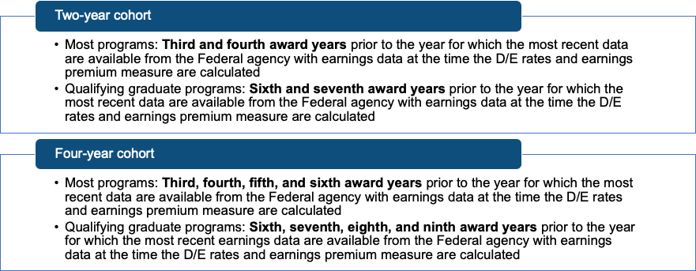
Cohort Periods
Notes:
So we know that a cohort consists of completer students from either a two-or-four-year period, but which two-or-four-year period are we talking about? ED has specified that, in the two-year cohort, for most programs ED will use the third and fourth award years prior to the year for which the most recent earnings data are available. The four-year cohort is determined similarly, but uses four prior award years. So for most programs in the four-year cohort, ED will use Third, fourth, fifth, and sixth award years prior to the year for which the most recent earnings data are available. ED has stated that, for this first round of metrics, the most recently reported earnings data will be for 2022.
For qualifying graduate programs, the two- year cohort will consist of students who completed in the Sixth and seventh award years prior to the year for which the most recent earnings data are available (again, that is calendar year 2022), and the Sixth, seventh, eighth, and ninth award years prior for students who completed a qualifying graduate program in the four-year cohort. This is to account for the periods that they're spending in post-graduation training, such as a medical residency, before they're able to practice in their field.

Slide 31
Student Exclusions
A student is excluded from the numerator and the denominator of the D/E and EP calculations if
One or more of the student’s Title IV loans qualify for a total and permanent disability (TPD) discharge;
The student enrolled full-time in any other eligible program at the same institution or another institution during the calendar year for which earnings were measured;
The student completed a higher-level undergraduate or graduate program at the institution (for undergraduate and graduate programs, respectively);
The student died; or
The student is enrolled in a program not subject to FVT/GE requirements

Slide 32
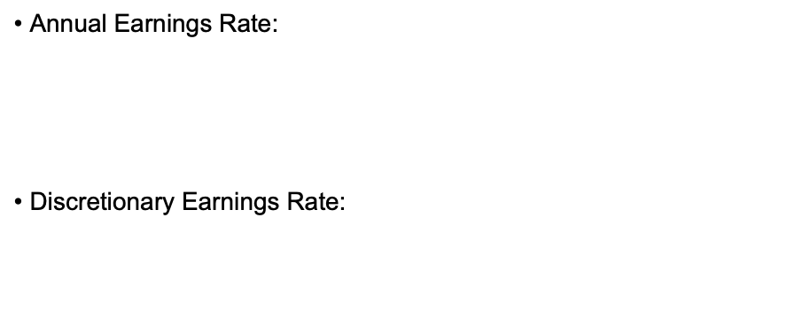
Debt to Earnings
Notes:
The annual earnings D/E rate is the ratio of a program’s annual loan payment amount to the annual earnings of the students who completed the program, expressed as a percentage. Basically what percentage of the student’s annual income is taken up by the student’s loan payment.
The discretionary rate is the percentage of a program’s annual loan payment compared to the discretionary earnings of the students who completed the program. And that formula is…
You may have heard of the term discretionary earnings (or income) before. It’s the same terminology used for determining a student’s payment under an income-driven repayment plan. It’s a percentage basis of the federal poverty guideline.
Now let’s tackle the individual components of these formulas…
The discretionary rate is the percentage of a program’s annual loan payment compared to the discretionary earnings of the students who completed the program. And that formula is…

Slide 33
Annual Earnings Rate: Annual Loan Payment
Calculated by determining the median loan debt of students who completed the program during the applicable cohort
Capped at the lesser of the
Total amount of debt the student incurred for the program; including Direct Loans*, Private education loans, and total amount outstanding on any other credit extended by the institution; or
Total amount of student’s tuition and fees, books, equipment, and supplies less the amount of institutional grant or scholarship funds provided the student
Median loan debt is amortized over the applicable repayment period using the prescribed interest rate
Notes:
The annual earnings D/E rate is the ratio of a program’s annual loan payment amount to the annual earnings of the students who completed the program, expressed as a percentage. Basically what percentage of the student’s annual income is taken up by the student’s loan payment.
The discretionary rate is the percentage of a program’s annual loan payment compared to the discretionary earnings of the students who completed the program. And that formula is…
You may have heard of the term discretionary earnings (or income) before. It’s the same terminology used for determining a student’s payment under an income-driven repayment plan. It’s a percentage basis of the federal poverty guideline.
Now let’s tackle the individual components of these formulas…

Slide 34
Annual Earnings Rate: Median Annual Earnings
Earnings are obtained from the federal agency with earnings data
A Federal agency with which the Department enters into an agreement to access earnings data for the D/E rates and earnings threshold measure.
May include the Treasury Department (including the Internal Revenue Service), the Social Security Administration (SSA), the Department of Health and Human Services (HHS), and the Census Bureau
The federal agency will pull earnings for students in the completer cohort and will provide to ED
Median annual earnings amount
Number of students who were not matched
The Department will exclude from the calculation of median loan debt the same number of students with the highest loan debts.

Slide 35
D/E Rates and Outcomes
What’s a good D/E rate?
A program passes the D/E rate metric if the annual D/E rate is 8 percent or less, or if the discretionary D/E rate is 20 percent or less.
The program only needs to have one of two rates fall into the acceptable range.
A program that fails both metrics is considered a high debt burden program

Slide 36
Earnings Premium Measure
Determined by subtracting an earning threshold amount from completers’ median annual earnings
The median earnings for working adults aged 25–34, who either worked during the year or indicated they were unemployed when interviewed, with only a high school diploma equals the earning threshold
Based on data from the census bureau
ED determines the earnings thresholds and will publish them annually via a notice in the Federal Register.

Slide 37
Earnings Premium Outcomes
Notes:
If the median annual earnings from your cohort exceeds the earnings threshold (even by just $1), the program passes the EP measure. If the median annual earnings of the students who completed the program are equal to or less than the earnings threshold (meaning your earnings premium is 0 or negative), the program is considered low earning.

Slide 38
Disclosure Requirements
Must provide relevant information needed to access ED’s website
Prospective students:
Before the prospective student signs an enrollment agreement, completes registration, or makes a financial commitment to the institution
Current students:
Prior to the start date of the first payment period associated with each subsequent award year in which the student continues enrollment at the institution

Slide 39
Notification of Determination
Notification includes:
Whether each program is passing or failing each of the measures
Whether prospective student acknowledgements are required
Notification specifically for GE programs also includes:
Whether the institution is required to provide student warnings;
Whether the program could become ineligible based on D/E rates or EP measure for the next award year; or
Whether the program is subject to a loss of eligibility due to failing D/E rates or EP measure in two out of three consecutive years for which metrics are calculated

Slide 40
Notification of Determination
When applicable, the notice will explain period of ineligibility
If ED does not calculate or issue D/E rates or EP measures for a program for an award year, the program remains in the same status for that measure as the previous award year
ED disregards any D/E rates or EP measures that were calculated more than five calculation years prior

Slide 41
Consequences for Failing GE and Non-GE Programs:
Student Acknowledgments
All eligible GE and non-GE programs with failing D/E rates
Undergraduate degree-granting programs are excluded from collecting student acknowledgments when those programs fail the D/E metric
Acknowledgment requirements do not apply if a program fails only the EP measure

Slide 42
Student Acknowledgments
Prospective students must acknowledge they have viewed information provided through ED’s website
Before the institution enters into an agreement to enroll the student.
Prospective students must provide acknowledgments until the earlier of:
The date ED notifies the institution that the program has passing D/E rates; or
Three years after the institution was last notified that the program had failing D/E rates
ED responsible for the content and delivery of the acknowledgements, collecting the acknowledgment from students, and for informing institutions which students have completed the acknowledgment

Slide 43
Consequences for Failing GE Programs:
Student Warnings
An institution must provide warnings to current and prospective students if its GE program could become ineligible based on D/E rates or EP measure for the next award year
If a current or prospective student receives a warning but does not seek to enroll until more than 12 months later, the institution must again provide the warning unless the program has since passed both the D/E rates and EP measure for the two most recent consecutive years
Must also provide translations of the English-language student warning for students who have limited proficiency in English

Slide 44
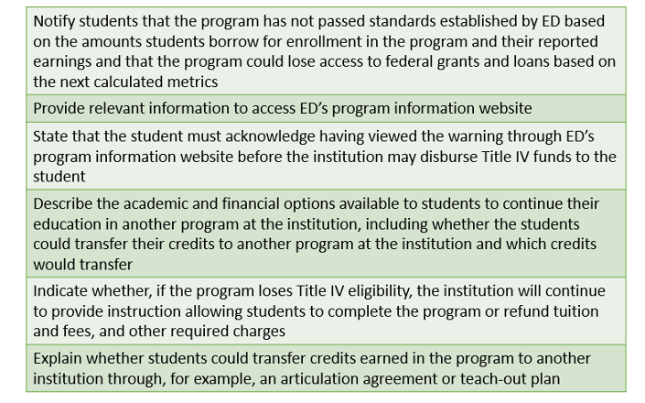
Student Warnings: Content

Slide 45
Student Warnings: Timing & Delivery
Enrolled students:
No later than 30 days after ED issues the notice of determination
Must be delivered in writing, either through hand-delivery, email, or by mail
Must be the only substantive content contained in the written communications
The institution must maintain records of its efforts to provide the required warnings

Slide 46
Student Warnings: Timing & Delivery
Prospective students:
Must provide the warning to each prospective student or to each third-party acting on behalf of the prospective student at the first contact about the program between the institution and the student/third-party
Must be provided by:
Hand-delivery: Provide the warning as a separate document, individually or as part of a group presentation
Email: Send the warning to the primary email address used by the institution. The warning must be the only substantive content in the email, and the warning must be sent by a different method of delivery if the email could not be delivered
Telephone: Provide the warning orally to the student or third-party if the contact is by phone

Slide 47
Consequences for Failing GE Programs:
Loss of Title IV Eligibility
GE program loses Title IV eligibility if it fails:
The D/E rates measure in two out of any three consecutive award years for which rates are calculated; or
The EP measure in two out of any three consecutive award years for which rates are calculated.
Institutions may appeal a GE program’s loss of eligibility due to a miscalculated D/E rate or EP measure

Slide 48
Loss of Title IV Eligibility: Period of Ineligibility
An institution may not:
Reapply to reestablish the eligibility of a failing GE program that the institution discontinued voluntarily either before or after the D/E rates or EP measure are issued for that program until three years after the institution voluntarily discontinued the program; or
Reapply to reestablish the eligibility of a failing GE program that is ineligible under the D/E rates or the EP measure until three years following the earlier of the date the program loses eligibility
Includes “substantially similar programs” which is any program with the same four-digit CIP code
After period of ineligibility, must apply for eligibility and provide GE certification

Slide 49
Financial Responsibility & Administrative Capability
Under 668.171(c)(2)(iii), an institution is not considered financially responsible if the institution received at least half of its Title IV funds in the most recently completed fiscal year in GE programs that failed either the most recent D/E rates or EP measures
Under 668.16(t), an institution is not considered administratively capable if at least half of its total Title IV funds in the most recently completed award year were from GE programs that failed either the D/E rate or EP measures

Slide 50
Could There Possibly Be Anything Else?
YES
Program length limitations: 34 CFR 668.14(b)(26)
GE certification: 34 CFR 668.604

Slide 51
Program Length Requirements
New regulations limit the number of hours in a GE program to the greater of the minimum number of clock hours, credit hours, or the equivalent required for training in the recognized occupation for which the program prepares the student, as established by the state in which the institution is located or, in some cases, another state
Revision of current “150-percent rule”
Some institutions may be required to reduce the number of credit or clock hours in a GE program to maintain Title IV eligibility
•Dear Colleague Letter GEN-24-06

Slide 52
GE Certification Requirements
Institutions must certify that each GE program it offers:
Is approved by a recognized accrediting agency or otherwise included in the institution’s accreditation by its recognized accrediting agency
Or, if a public vocational institution, is approved by a State agency recognized to approve such programs in lieu of accreditation
Transitional certification required for currently participating institutions offering GE programs
Must be submitted no later than December 31, 2024 (with certain exceptions)
Dear Colleague Letter GEN-24-04

Slide 53
Thank you for your time!
Dana Kelly
NASFAA
Kellyd@nasfaa.org

Slide 54
Notes:
JD

