Slide 1
Yearly Calendar Operations
Dr. Sharon J. Oliver
North Carolina Central University
November 6, 2024
Fall 2024: Climbing Higher Together

Slide 2
Agenda
Definition of Operational Calendar
Reasons for Creating an Operational Calendar
Key Factors to Consider When Developing the Operational Calendar
Obtain Pertinent Documents
Essential Areas to Include
Identify the Format
Maintaining the Calendar
Examples

Slide 3
Confucius said:
“A man who does not plan long ahead will find trouble
at his door.”

Slide 4
Definition of an Operational Calendar
From the Merriam-Webster online dictionary:
Operational – ready for use: able to be used; ready for or in condition to undertake a desired function
Calendar – a list or schedule of events or activities that occur at different times throughout the year; an orderly list.

Slide 5
Reasons for Creating an Operational Calendar
COMPLIANCE
Compile all relevant events, meetings, activities, deadlines, timelines required to meet deadlines, reports, time sensitive tasks, etc. in one place
Inform Campus Partners and Supervisor of full scope of FA responsibilities
Reduce/eliminate missing key deadlines or last-minute rush to meet deadlines
Encourage accountability Among staff/Staff are Aware of Tasks
Utilize for Staff Training/Resource for Staff Turnover
Financial Aid is very cyclical
We are often doing the same tasks at around the same time each year….but might only do that task once a year so it’s not always on our minds.

Slide 6
Key Factors to Consider When Developing the Operational Calendar
Size of office
Office Structure
Will it be for all staff and/or managers?
Will there be separate calendars for different areas/departments of the office? If so, will there still be a master calendar?
Will there be separate calendars for the types of items/activities included (institutional, state, federal, etc.)? If so, will there still be a master calendar?

Slide 7
Obtain Pertinent Documents
Start with any prior calendars that have already been created
Read prior e-mails from respective time periods
Solicit staff input via e-mail
Discuss at staff meetings
Review information already available on your school’s website or in printed publications

Slide 8
Essential Areas to Include: Institutional Information
Academic calendar dates: first day of classes, census date, last day to drop, last day to withdraw, last day of classes, etc.
College-wide events – Faculty/Staff Institute, Commencement
Admissions Open Houses/New Students Orientation Sessions
Scholarship Deadline
Registration for classes/First Day to Charge Books/First Day to Credit Refund
Billing due dates/Drop for Non-Payment Dates/Insurance Waiver Deadline
Holidays and class breaks
Residency Determination System Deadline (RDS)

Slide 9
Key Areas to Include: Administrative Tasks
Staff Performance Evaluations
Management report deadlines
Office budgets (Conferences, Training, etc.)
System setup (Releases and Patches)
Regular External Meetings/Staff Meetings
Auditor Visits
Annual training events (inside and outside aid office)
Cost of Attendance construction/updates
Polices and Procedures Review/Updates
Blackout Dates

Slide 10
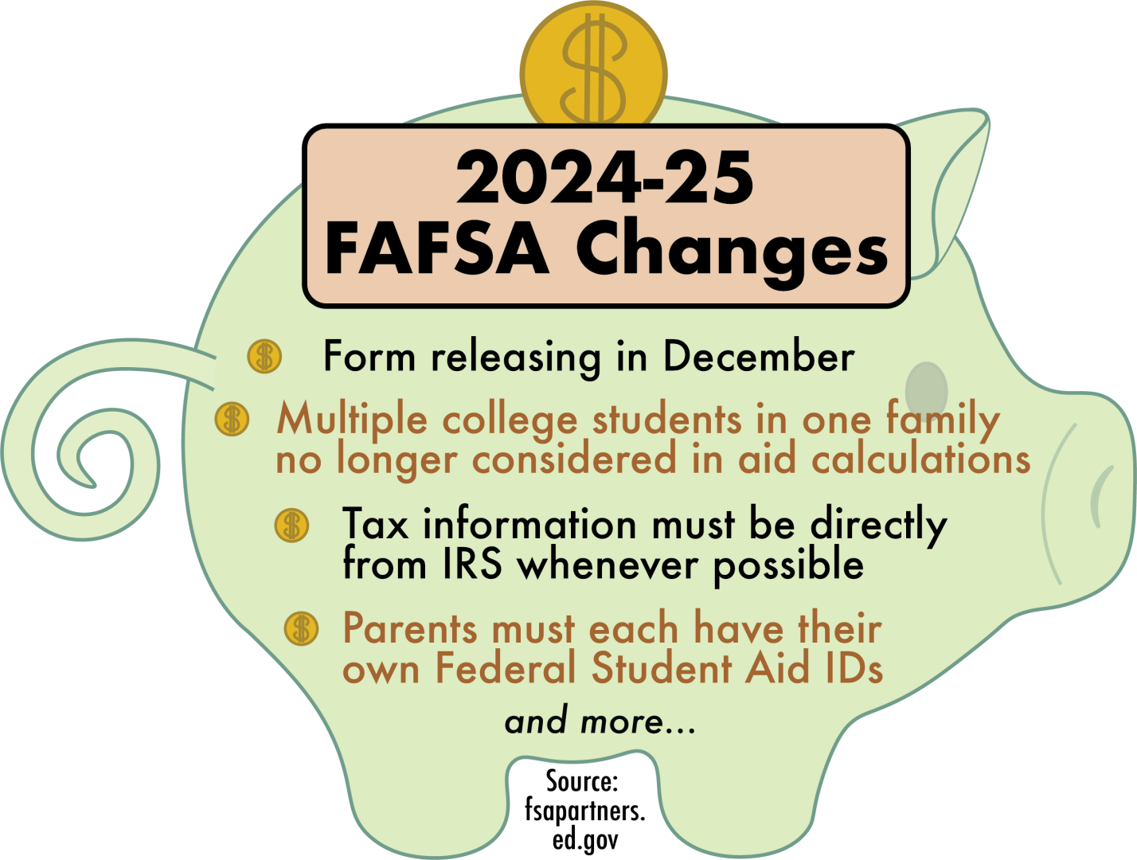
Key Areas to Include: Communications
Annual Financial Aid Publications
Website Updates
School Catalog
Consumer Information
FAFSA Filing Reminders/Priority Date
Award Letter Disclosures
Cost of Attendance Components
Current and Prospective Student Notifications
Prospective Graduates Requirements

Slide 11
Key Areas to Include: Federal/State Reporting
FISAP deadlines
FTV/Gainful Employment Reporting
Return to Title IV (R2T4) calculations and Refunds/Returns
V4/V5 Verification Reporting
FWSP Expenditure Report
State program reporting
FWSP and Direct Loan Closeouts
Net Price Calculator Updates

Slide 12
Key Areas to Include: Federal/State Reporting
Annual Security Report
Campus-Based Award Reduction Penalty Waiver Request for Underuse of Prior Year Funds
Campus-Based Reallocation Application/Request for Supplemental Funds
Request for a Waiver of FWS Community Service Expenditure Requirement

Slide 13
Key Areas to Include: Awarding/Processing Tasks
Processing FAFSAs
Submitting Corrections to FPS
Awarding/Packaging Aid
Processing Professional Judgment Appeals
Satisfactory Academic Progress (SAP) Review Dates, Notices, Appeals
Spring/Summer awarding
Scholarship Renewal Reviews

Slide 14
Key Areas to Include:
Program Specific
Dates/Timelines/Deadlines
Federal Work-Study
Due Dates for Timesheets
Finalize Off-Campus Contracts/Agreements
Payment Dates
Update Job Descriptions
Federal Stafford/Plus Loans
Last Date to Originate Loans
First Date to Disburse Loans

Slide 15
Key Areas to Include: Other
Staff Birthdays
Annual Surveys (IPEDS)
Conferences (NCASFAA, SASFAA, NASFAA, Federal Student Aid)
NCAA Reporting
Office/staff retreat
Outreach events

Slide 16
Identify the Calendar Format
Paper format and Stored on the Office Network Drive
Electronic Version with Shared Update Access
Electronic Version with Limited Update Access
Organized by Functional Areas, Key Positions, Specific Staff
Verification of Calendar Updates (Who, When)
E-Calendar Notifies Team of New Updates

Slide 17
Maintaining the Calendar
Assign to one or more individuals; if more than one, how will changes be coordinated?
Review periodically at staff meetings – documenting what has recently occurred and looking forward to upcoming events/deadlines
Continue to monitor e-mails for new items to add
Provide management oversight
Perform the Necessary Updates Timely

Slide 18
Yearly Calendar Operations Examples

Slide 19
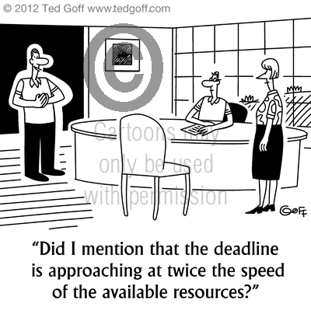
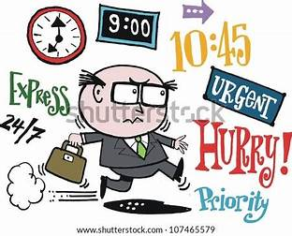
FTV/GE

Slide 20
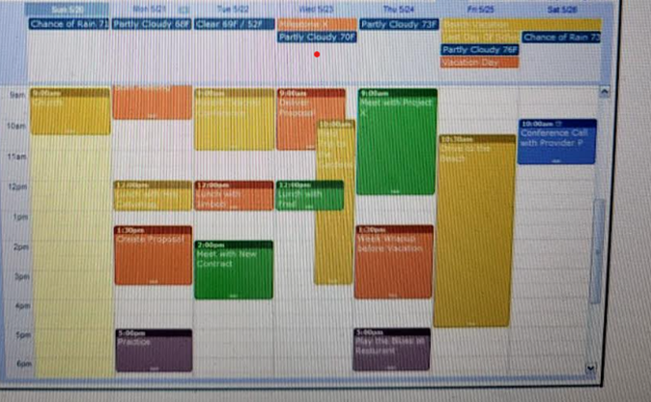
Fall 2024: Climbing Higher Together

Slide 21
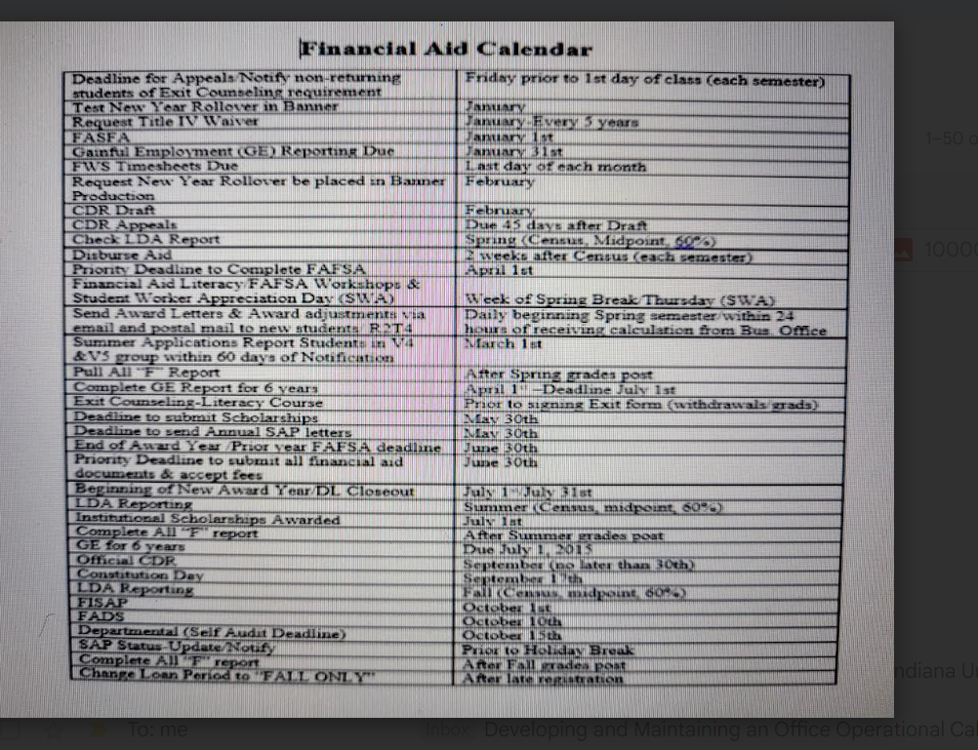
Fall 2024: Climbing Higher Together

Slide 22
Fall 2024: Climbing Higher Together

Slide 23
Fall 2024: Climbing Higher Together

Slide 24
START Your Operational Calendar
TODAY

Slide 25
Questions?

Slide 26
NCASFAA Thanks our Platinum Sponsors

Slide 27
NCASFAA Thanks our Gold Sponsors

Slide 28
Thank you for attending!
Fall 2024: Climbing
Higher Together

